Slide 1

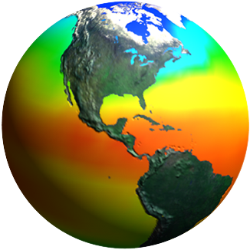
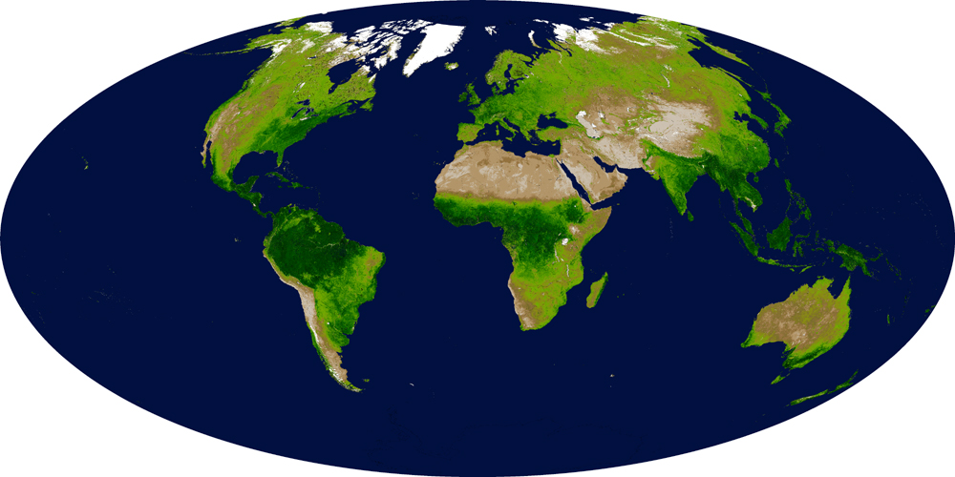
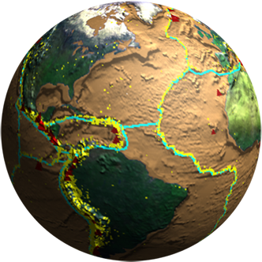
Biodiversity and Ecological Forecasting Team Meeting
Hilton Alexandria Mark Center, Alexandria, VA
A Global Biodiversity Observation System
An EOS for a Changing Biosphere
Woody Turner
Earth Science Division, NASA Headquarters
October 5, 2011

Slide 2
Taking Wisdom from the Market
“Diversification is not only the first important thing investors should think about, but the second and the third, and probably the fourth and fifth, too”
John C. Bogle (82) founder of the Vanguard Group in The Wall Street Journal September 10, 2011, Jason Zweig’s The Intelligent Investor, in which he also referred to the stock market as “spasmodic”

Slide 3
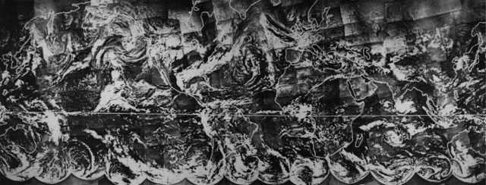
Our Ever-Changing Earth
(source: Smithsonian NASM Looking at Earth TIROS Page)

Slide 4
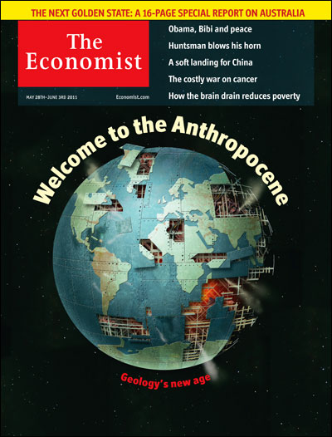
We Are a Driver of Global Change
(But Can/Will We Take Responsibility?)

Slide 5
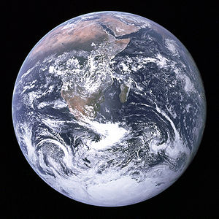
Looking at Earth as a Planet
(from Apollo 17 Crew; December 7, 1972)

Slide 6
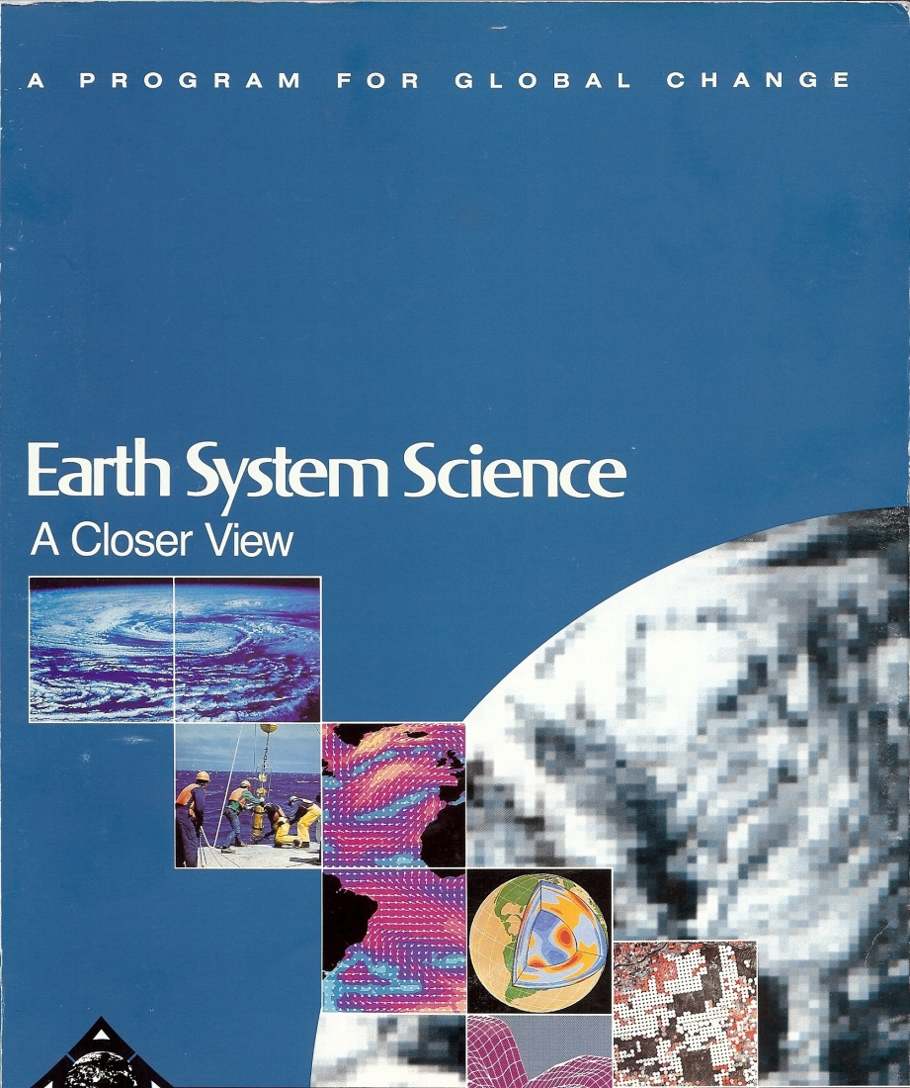
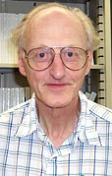
The Bretherton Report:
Earth System Science’s Founding Text and Plan
“The understanding of global change on time scales of decades to centuries is a challenge of great urgency.”
Earth System Science: A Closer View p.16 (1988)
Progress requires vision and persistence;
we’ve stuck with this vision for >20 years.

Slide 7
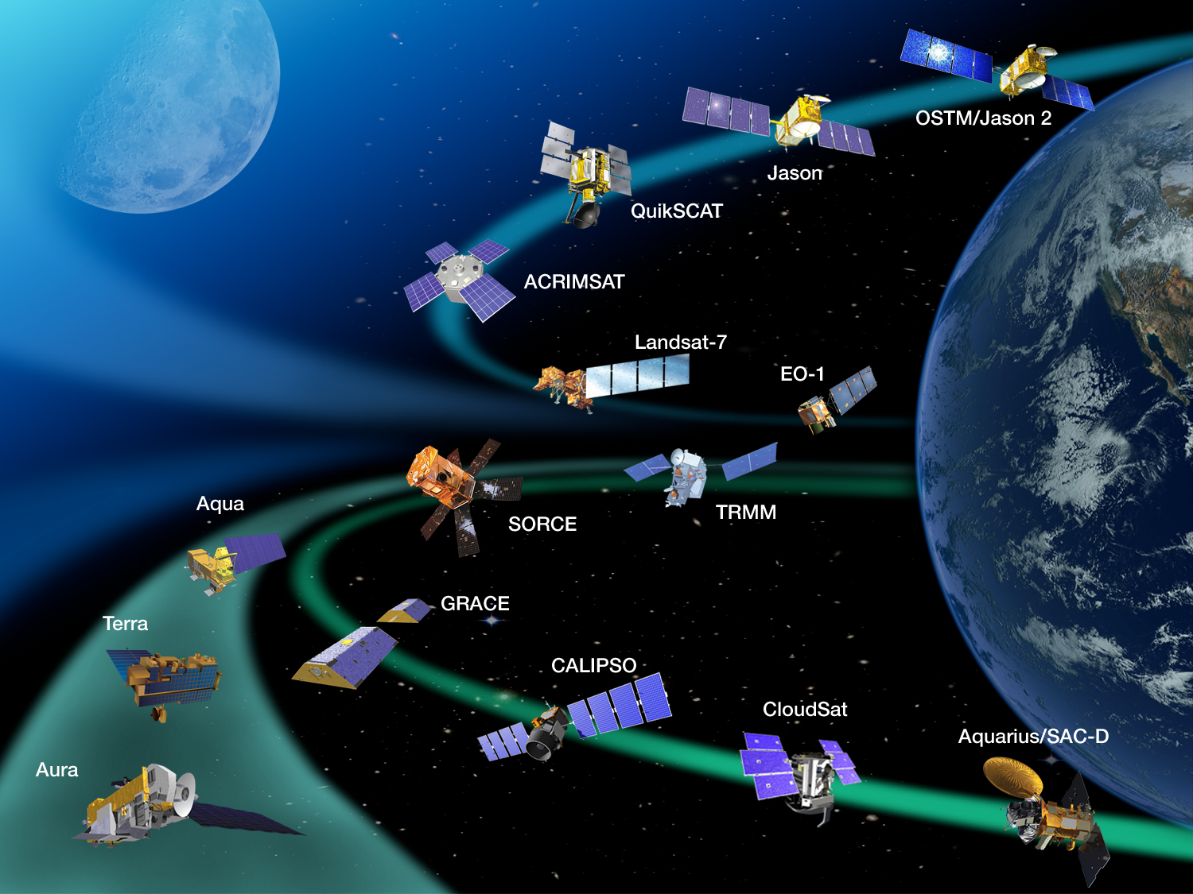
The Plan Has Worked

Slide 8
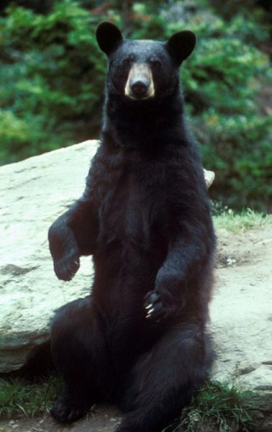
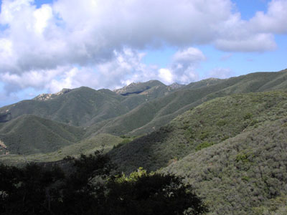
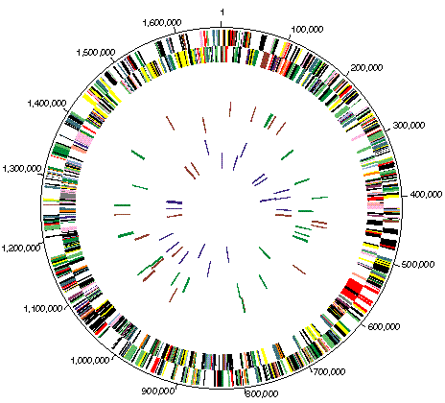
Biodiversity: the Variability of Life on Earth
(Source: Wikipedia)
Helicobacterium pylorii Genome from:
http://biocrs.biomed.brown.edu/Books/Chapters/Ch%2038/Pylori-Genome.gif
(Source: Wikipedia)
Biodiversity is life’s response to a changing planet as well as a driver of environmental change at all spatial scales. It captures our evolutionary past and provides opportunities for our living future. We, and all life, need biodiversity for the same reason we need a diverse financial portfolio—things change.

Slide 9
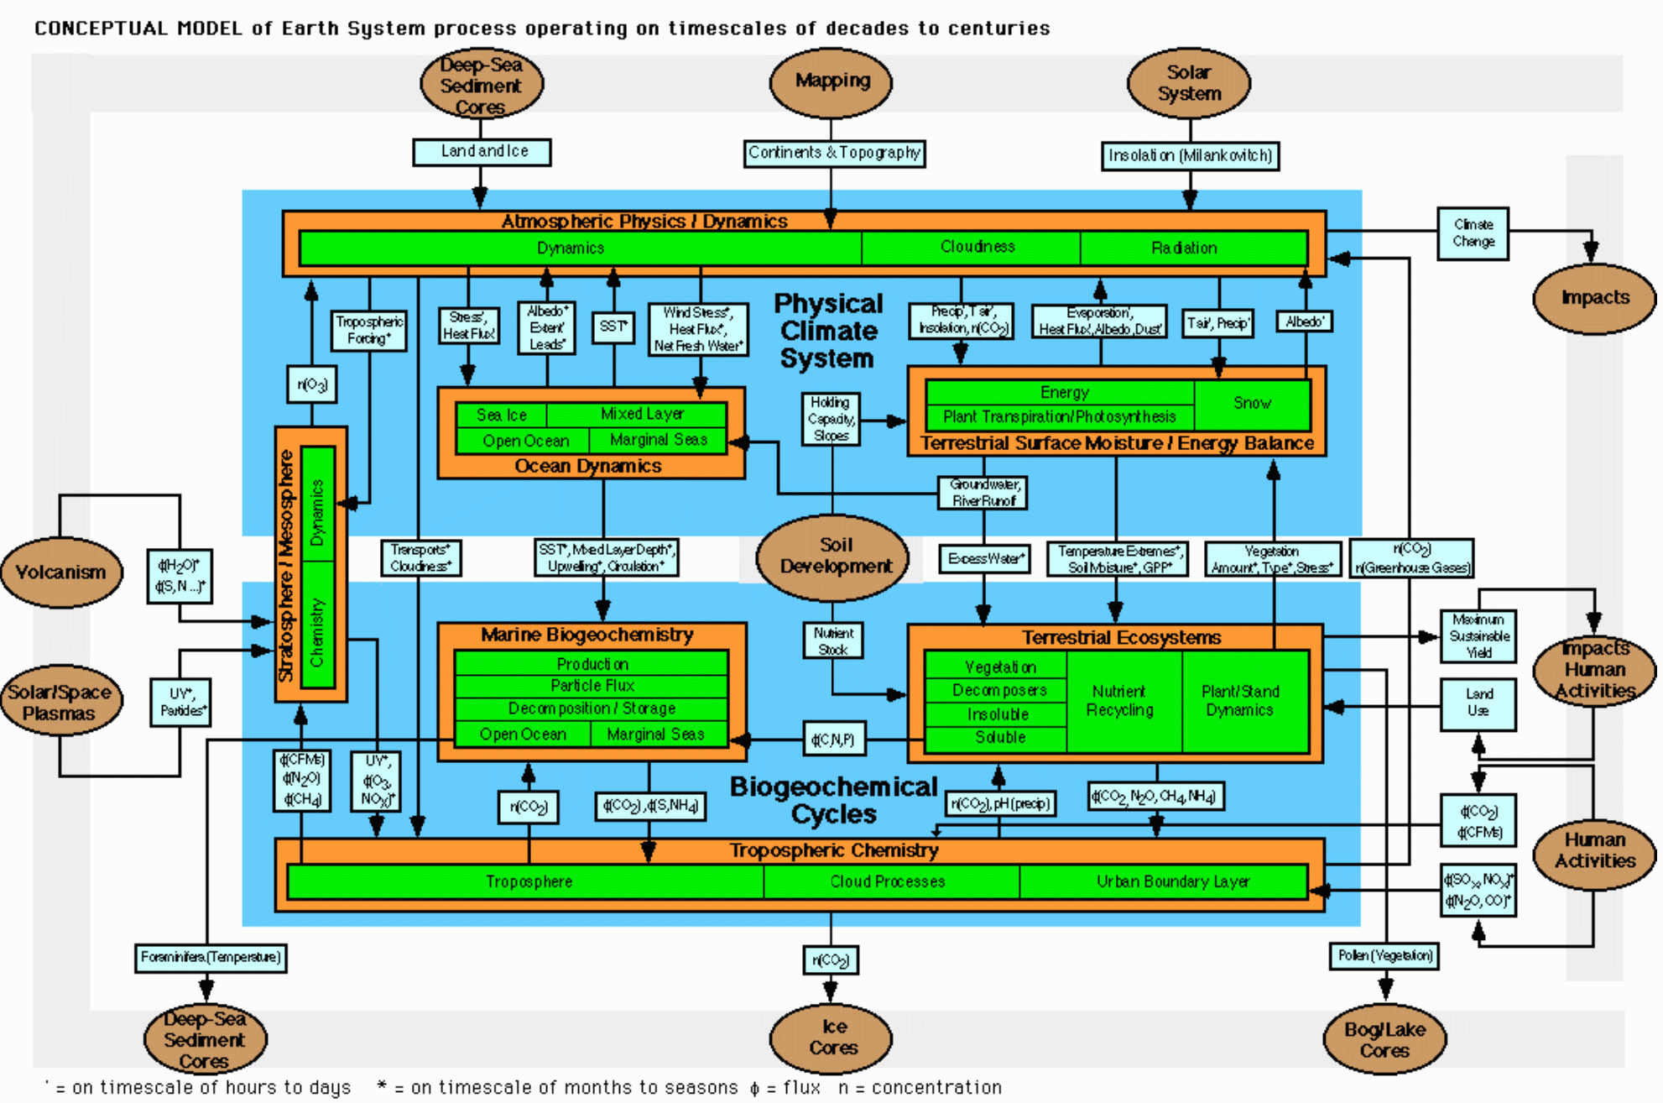
Where’s the Biodiversity?
(Earth System Science: A Program for Global Change (1988))

Slide 10

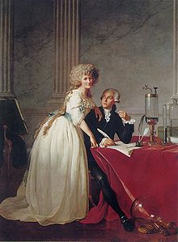
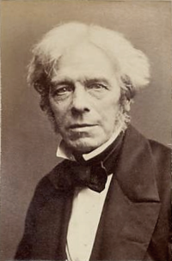
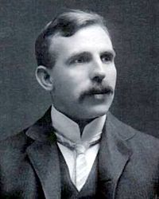

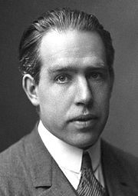
The New Century of Biology?
(with apologies to Mendel, Wallace, Darwin)
(photos source: Wikipedia)
BOYLE LAVOISIER FARADAY RUTHERFORD EINSTEIN BOHR
Who’s Next?
But it’s contingent on biodiversity: the key to unlock the door to all levels of biological discovery.
A new age of opportunity awaits!

Slide 11
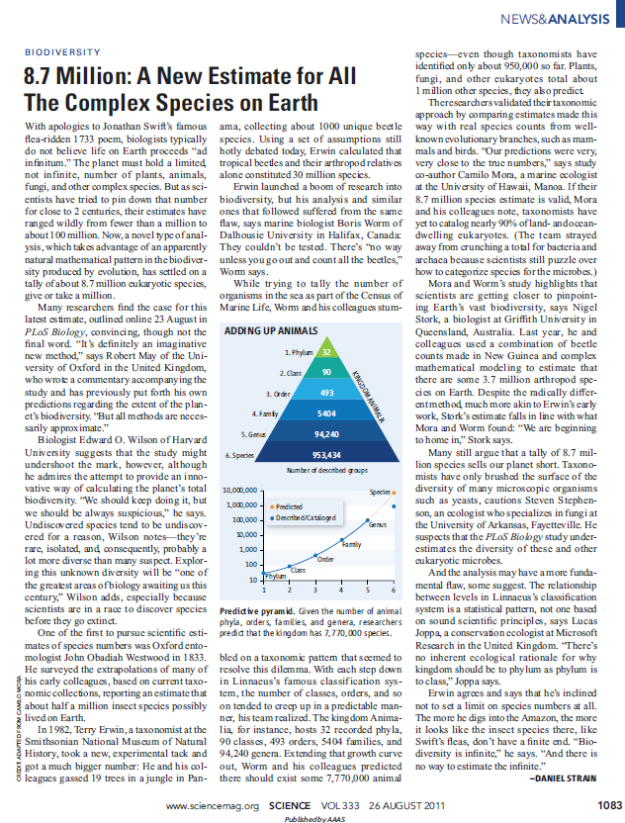
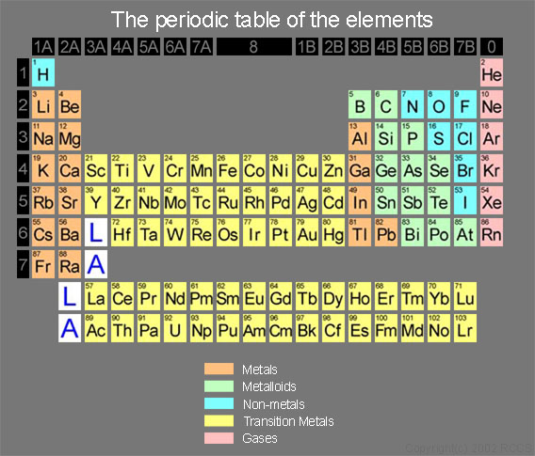
Lord May’s Lament: There’s So Much We Don’t Know
BIOLOGY
(http://ccinfo.ims.ac.jp/periodic/periodic.jpg)

Slide 12
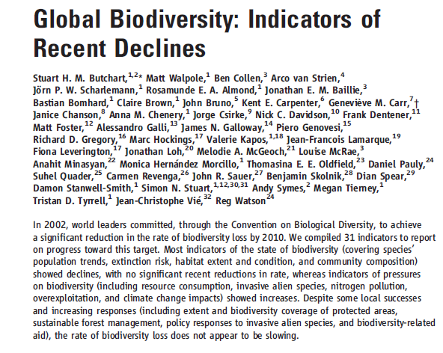
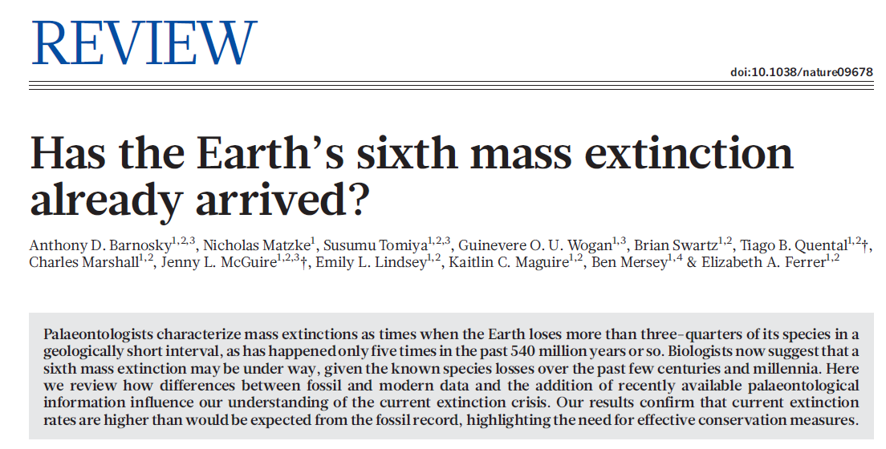
Yet Time Is Short!
(Nature 471:51-57; 3/3/11)
(Science 328:1164-1168; 5/28/10)
So, what do we do?

Slide 13
How About an EOS for Life on Earth?
?
1988
2011
It’s now possible.

Slide 14
Why Global Data Products?
Consistency across data → comparability across space and time
Shared methods
Standardization of formats
Cost efficiencies associated with designing, implementing and integrating systems to produce the products
Common scorecard for users
Open to improvements from the global community
Incentive and instruction for national/or and regional monitoring systems
Provision of a global context for local actions and management decisions
Avoid “leakages” of economic or other impacts from one country to another, which can be a problem with national-level assessments
“Scale-ability” spatially is a necessity

Slide 15
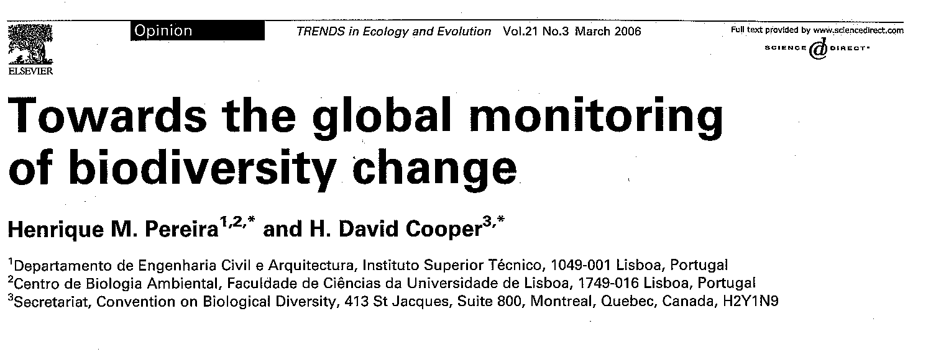
Two components: Ecosystems and Species
Calls for regular global sampling along with a global network of regional monitoring programs for indicator populations
For Ecosystems: global land cover via remote sensing (for oceans, suggests combining regional analyses but can also capture some ocean conditions globally with satellites via NPP per OSU/Behrenfeld, others)
For species: Living Planet Index (LPI), global assessments, and regional monitoring
Notes the importance of a composite index to integrate ecosystems and species change data (e.g.: Biodiversity Intactness Index)
Suggests Group on Earth Observations GEOSS and UNEP play key roles in forming and supporting the monitoring network

Slide 16
Do We Have the Pieces We Need to Start a Global Biodiversity Observation Network?
Global measures of land cover and ocean productivity at different scales
Global measures of the status of key elements of biodiversity (e.g., species) at different scales
A means of integrating these global measures
An institutional framework to establish and oversee the monitoring network

Slide 17
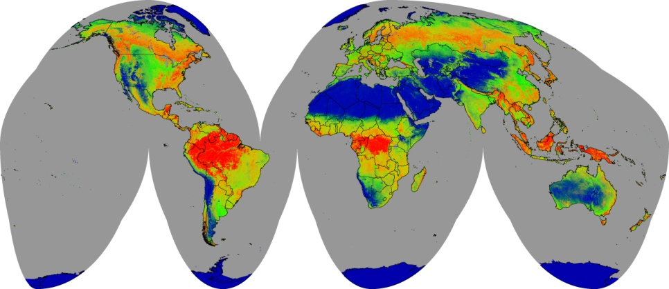
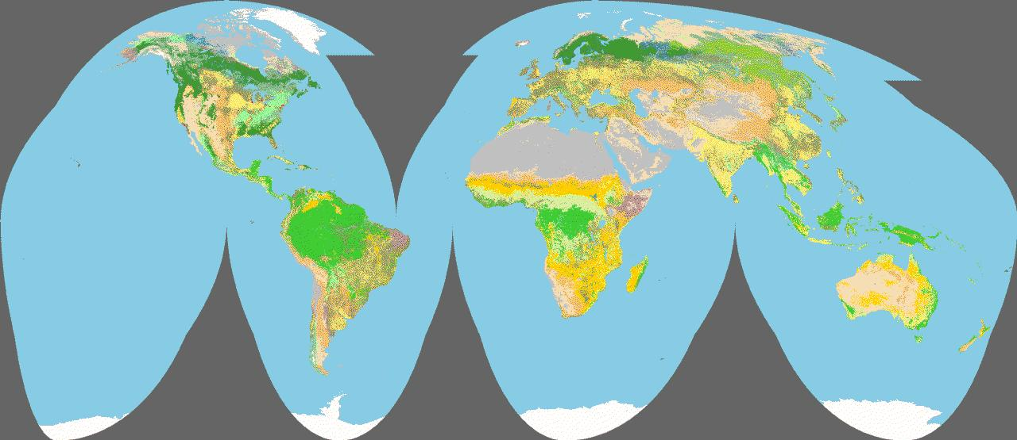
GEO Global 30m Land Cover
Annual land cover continuous variables
Mid-decadal year land cover types
Quantitative annual continuous measures of per pixel percent tree, shrub, herbaceous, water, snow/ice, and barren cover.
Change products annually
2010 baseline
Land cover categories (TBD) consistent with FAO Land Cover Classification System (LCCS)
Maps and statistical estimates of major land cover types
Complementary with other global land cover products (e.g., MODIS land cover, Globecover)
2010 baseline, 5-year updates
(from USGS/Tom Loveland)

Slide 18
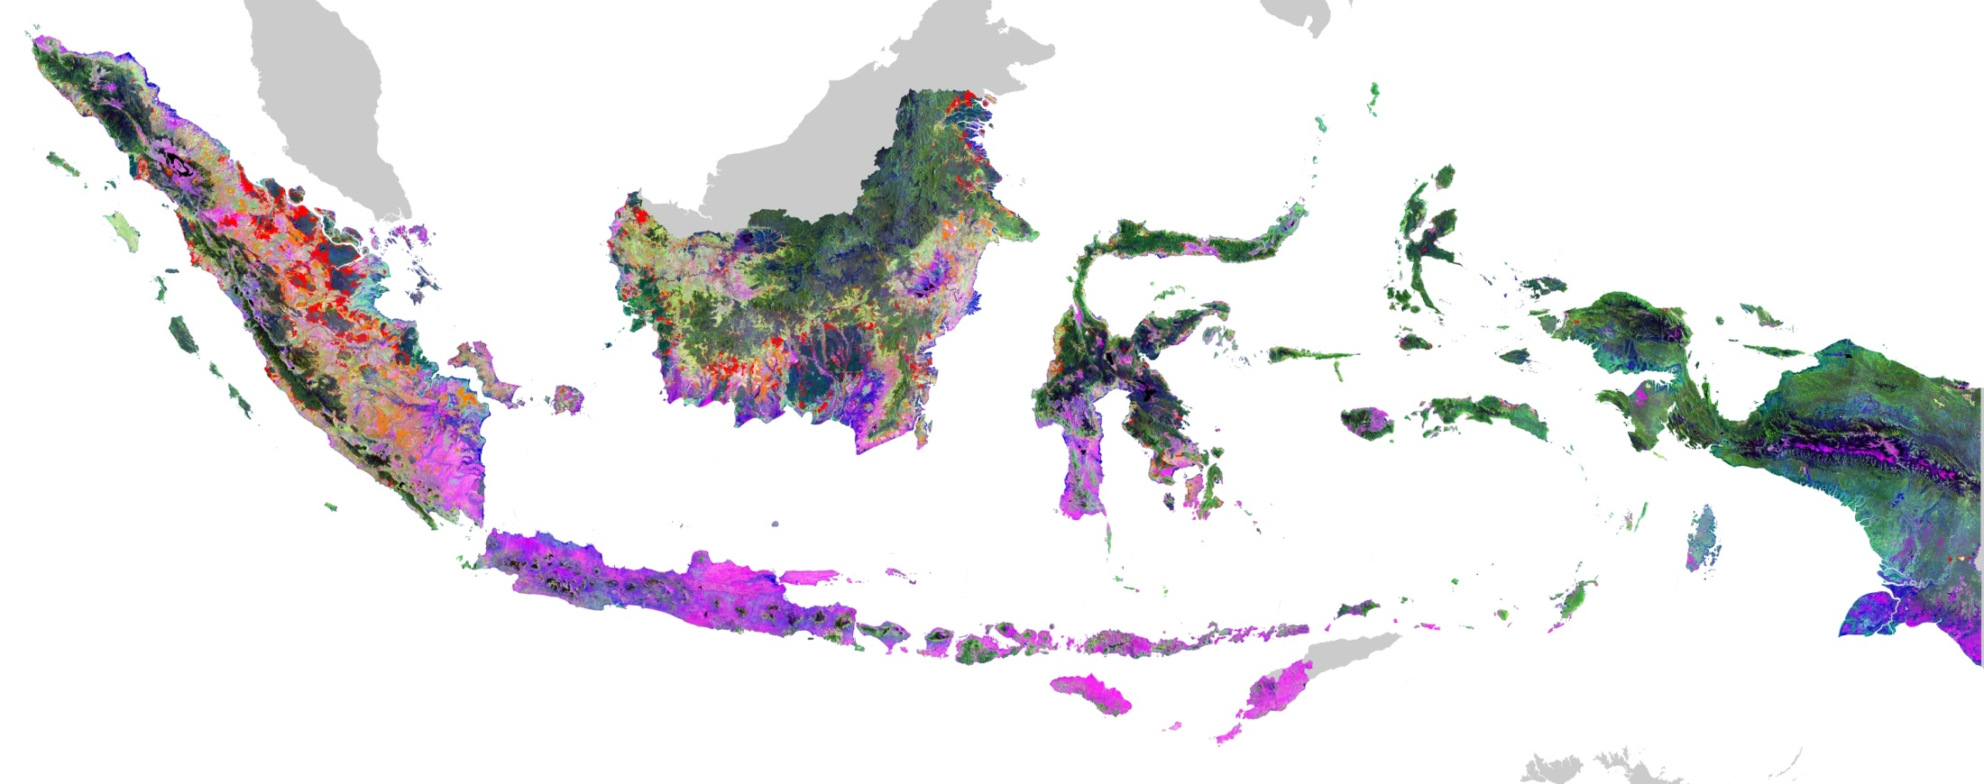

The MODIS-ization of Landsat
Forest cover loss in Indonesia, 2000 to 2010
15,692 Landsat Enhanced Thematic Mapper Plus images from 1999 to 2010
Open data archives + cloud computing = mapping the globe!
Primary forest cover loss
Other forest cover loss
Nearly 1 million hectares per year, almost half in primary forests
(from SDSU/Matt Hansen)

Slide 19
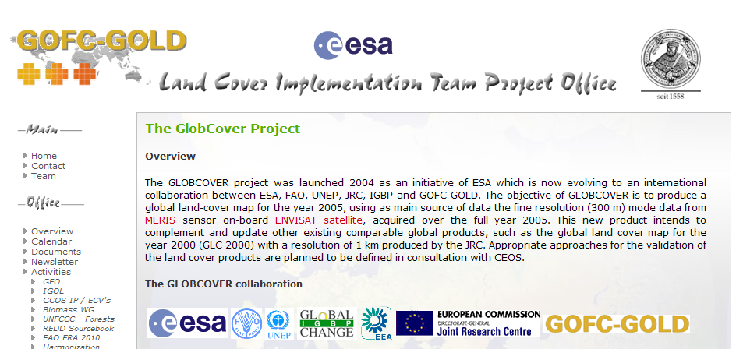
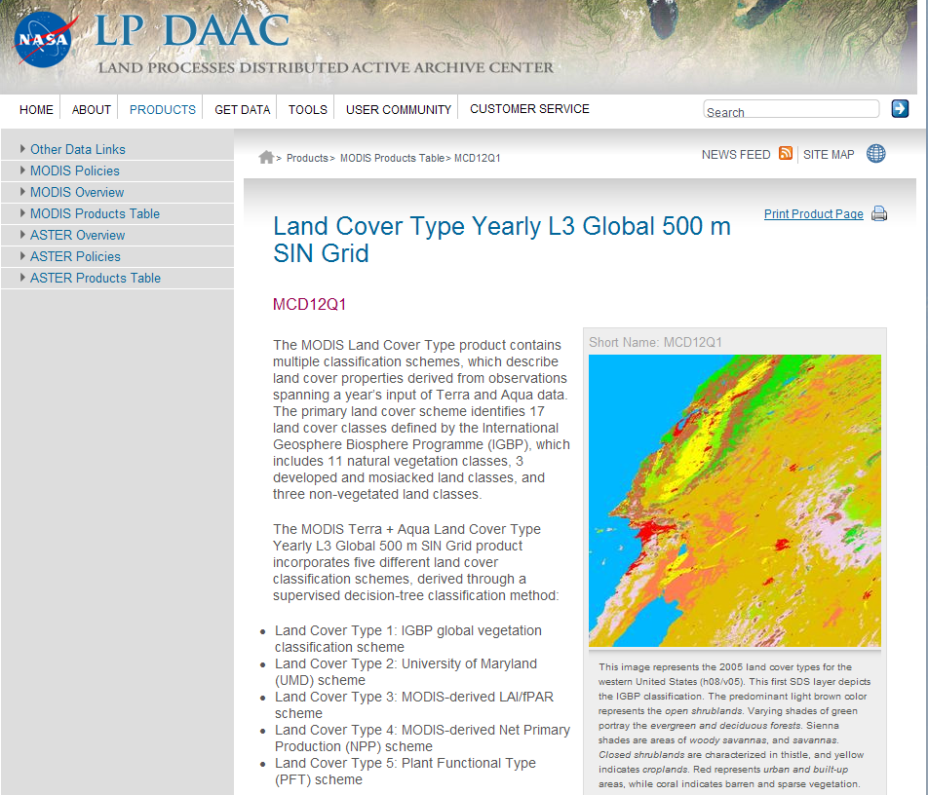
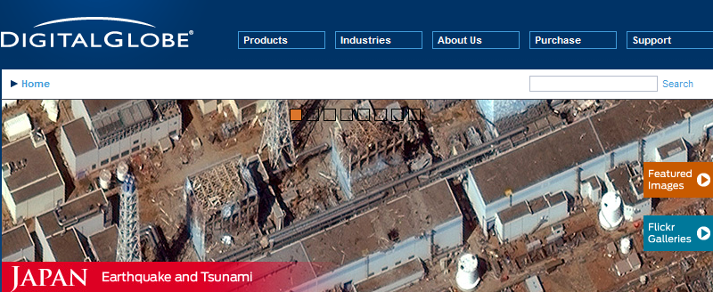
Improving Temporal/Spatial Resolution and Capturing the 3rd Dimension
Temporal: AVHRR, MODIS, MERIS, Sentinel-3
Spatial: Commercial satellites, airborne sensors
Active: radar (Japan, Sentinel-1)
lidar (GLAS, airborne)

Slide 20
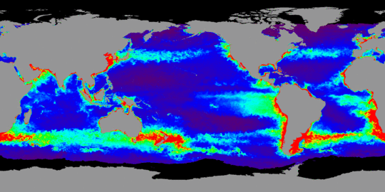
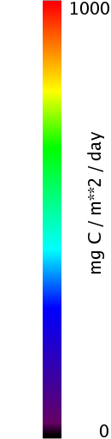
NPP for Oceans
Monthly Net Primary Production for November 2002
Standard Product: Net Primary Production using MODIS CHL and SST, SeaWiFS PAR, and z_eu = f(CHL) as inputs to the VGPM
(from http://www.science.oregonstate.edu/ocean.productivity/index.php)

Slide 21
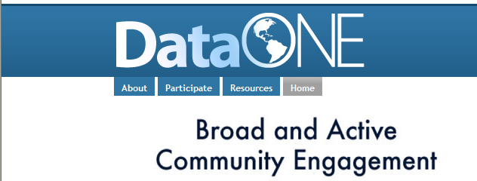
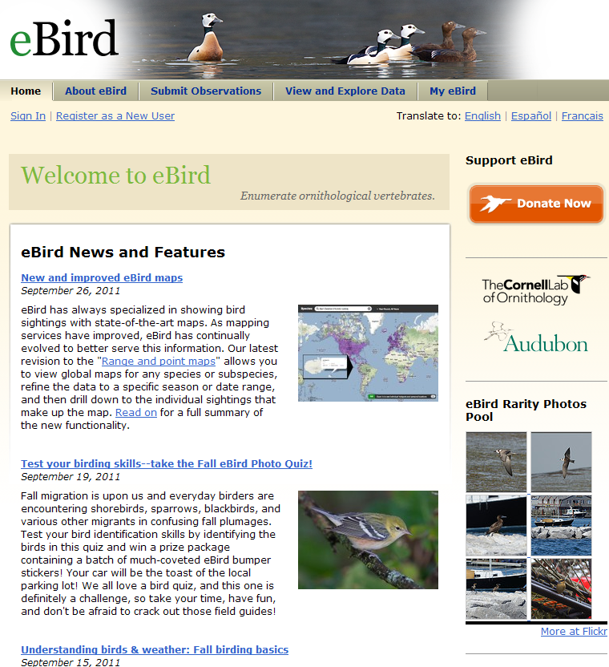
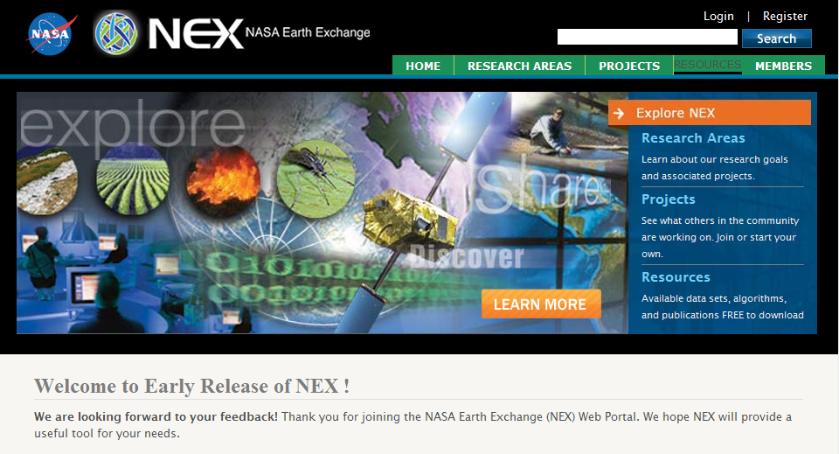
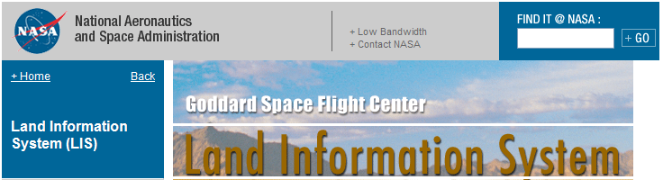
Bringing Process to Patterns Seen in RS Imagery

Slide 22
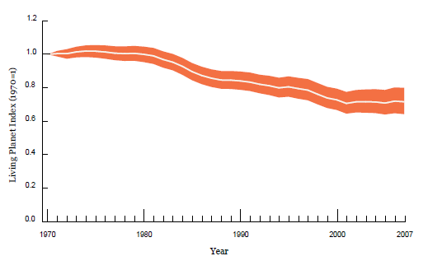
ZSL/WWF Living Planet Index
Estimates annual rates of change for 7953 populations of 2544 mammal, bird, reptile, amphibian, and fish species
Global overall LPI
Combines Temperate (Palearctic and Nearctic realms and marine species north and south of the Tropics) and Tropical ( Afrotropical, Indo-Pacific and Neotropical realms and marine species within the Tropics) LPIs
Can disaggregate into:
  Terrestrial, Marine, and Freshwater LPIs
  LPIs by realm
  Track individual species
Also Red List Index for changes in extinction risk
Stuart et al. (Science 328:177; 2010) call for better Barometer of Life
  Adding taxonomic depth to the Red List
(Source: WWF’s Living Planet Report 2010 Summary)

Slide 23
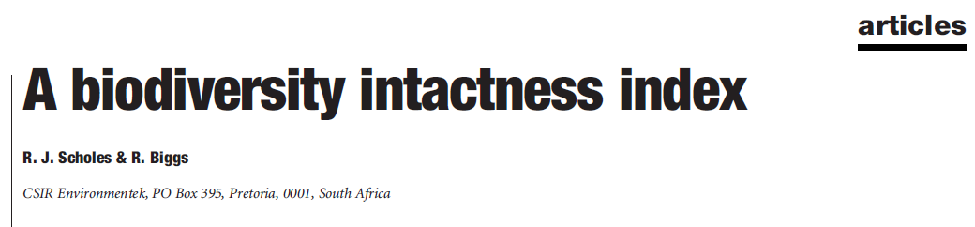
BII: A Composite Index to Integrate Habitat and Species Data
Biodiversity Intactness Index (BII) from Scholes and Biggs in Nature (434:45-49; 2005)
Links land use classes to ecosystem types and population impacts for species groups or groups of functional types
Comparable directly within and across scales (tested at national, provincial, and local scales in South Africa, as well as across southern Africa
Presents results as percent intactness = percent remaining of presumed pre-modern levels
Can be disaggregated by ecosystem, political unit, taxon, land use
Includes an error bar for uncertainty

Slide 24
Group on Earth Observations (GEO)
A Possible Framework?
Detailed Implementation Plan completed in May 2010
Includes sections and working groups with specific
activities and deliverables for:
  Genetics / Phylogenetic Diversity (WG 1)
  Terrestrial Species Monitoring (WG 2)
  Terrestrial Ecosystem Change (WG 3)
  Freshwater Ecosystem Change (WG 4)
  Marine Ecosystem Change (WG 5)
  Ecosystem Services (WG 6)
  In Situ / Remote Sensing Integration Through Modelling (WG 7)
  Data Integration and Interoperability (WG 8)
(http://www.earthobservations.org/geobon.shtml)

Slide 25
Some Key Points
Open data policies are required! Without them, this global observation system cannot work.
Bottom Up & Top Down Observations; Modeling All the Way Across
  It’s imperative to link people from the remote sensing and biodiversity research and conservation communities for this “top down” and “bottom up” approach to succeed. They must work together to build the network.
Simplify, Simplify, Simplify (i.e., for global efforts pick a few sample taxa and biome/ecosystem types at outset; sampling is ok)
There’s More than Enough Work to Go Around→Partnerships
Move Out on All Fronts at Once = Do What We Can Now for Assessments, Monitoring, Models
Calibration and validation of all datasets are vital.
  In some cases, we can take advantage of well-characterized biodiversity sites for cal/val of imagery products and also use this as a rationale for establishing more sites (e.g.: a network of biodiversity supersites?).
  Global Reference Frame required
Involve Governments or Perish—but not just Governments
Use the Web and Web Tools (for Data access) as well as to Multiply Arms and Legs (and Public Support!) through Citizen Science

Slide 26
Let’s Get Started
The pieces appear to be there:
  Work with GEO BON to support framework
  Connect with GEO High Resolution Land Cover Group (USGS/Tom Loveland and Wageningen/Martin Herold) to understand product and imprint biodiversity needs on it
  Work with ZSL on the potential application of the LPI
  Develop the BII (or another index) as a global tool integrating species population data and remotely-sensed ecosystem condition
  Consider funding sources for a global observation system
Community Support is vital.
Unveil plans for global monitoring system at the World Conservation Congress in 2012 or Earth Summit 2012?
Be bold!
We Can Do This!

Slide 27
Thank You!
If you’re interested in discussing this topic, please come to this Team’s Open Forum tomorrow at 3:45PM.

